Slide 1
Ethical Student Hackers
OSINT

Slide 2
The Legal Bit
The skills taught in these sessions allow identification and exploitation of security vulnerabilities in systems. We strive to give you a place to practice legally, and can point you to other places to practice. These skills should not be used on systems where you do not have explicit permission from the owner of the system. It is VERY easy to end up in breach of relevant laws, and we can accept no responsibility for anything you do with the skills learnt here.
If we have reason to believe that you are utilising these skills against systems where you are not authorised you will be banned from our events, and if necessary the relevant authorities will be alerted.
Remember, if you have any doubts as to if something is legal or authorised, just don't do it until you are able to confirm you are allowed to.
Relevant UK Law: https://www.legislation.gov.uk/ukpga/1990/18/contents

Slide 3
Code of Conduct
Before proceeding past this point you must read and agree to our Code of Conduct - this is a requirement from the University for us to operate as a society.
If you have any doubts or need anything clarified, please ask a member of the committee.
Breaching the Code of Conduct = immediate ejection and further consequences.
Code of Conduct can be found at https://shefesh.com/downloads/SESH%20Code%20of%20Conduct.pdf

Slide 4
OSINT - What is it?
Open Source Intelligence - Using publicly available information to collect details about a person or group

Slide 5
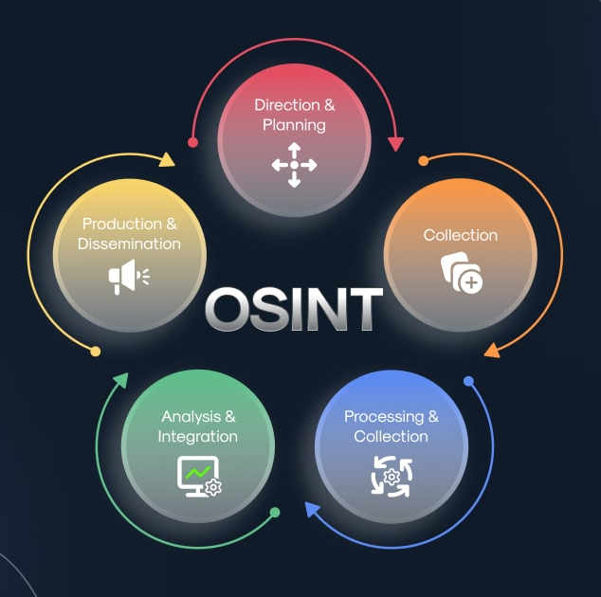
OSINT - What is it?
Open Source Intelligence - collection and analysis of data gathered from open sources (overt sources and publicly available information) to produce actionable intelligence
Malicious use: Protection use:
Cyber criminals - Data protection
Marketing - Cybersecurity defense
Note: Intelligence ≠ Information
Information only becomes Intelligence when we look at it in a critical manner, analysed and given meaning

Slide 6

FAMOUS FAILURES (KIND OF)
Venmo public by default transactions.
Until 2021 all venmo payments were public by default.
This lead to many people accidentally sharing valuable information about themselves. For better or worse.
In 2018 a US congressman paid accused sex offender seemingly for prostitution.
In 2019, a privacy researcher analysed millions of venmo transactions to make detailed profiles of all individuals who had not turned off the setting.
This kind of information can easily be used maliciously
Notes:
US congressman paid accused sex offender seemingly for prostitution.

Slide 7

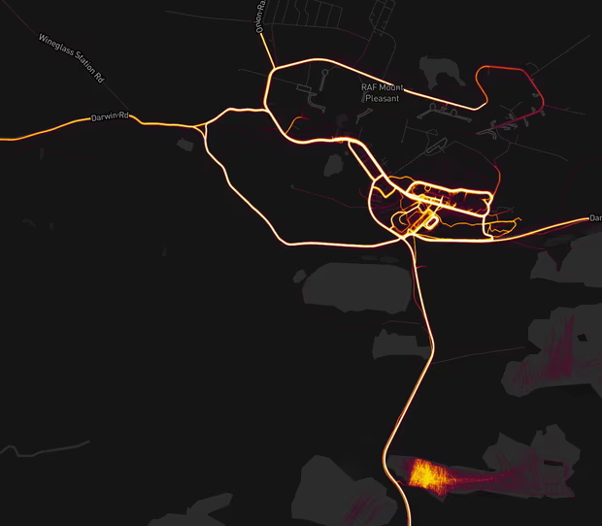
FAMOUS FAILURES
Strava heatmap failure
In November 2017 more than 3 trillion individual GPS data points were released by Strava (A sports social media) of every single activity - Even private ones - as a heatmap.
This was cool, but also terrible for operational security. For example US international bases were easily visible and easy to map due to there being not many other strava users in certain areas e.g Syria, Afghanistan
One cyclist mapped out the whole west side of the famous area 51.

Slide 8
WHY?
OSINT allows us to monitor everything in real time completely legally and ethically.
In everyday life the information we empower ourselves with can give us the slight edge in such a media driven world. As well as verifying the authenticity of sources and info given by others.
It equips us decision makers to make better, more informed decisions by monitoring and analyzing public opinions and sentiments.
As ethical hackers we can use OSINT to investigate potential security threats or vulnerabilities to prepare an attack.
It can also enhance traditional intelligence gathering which can prepare us for a social engineering attack and help us make better decisions later on in the attack.

Slide 9
USEFUL WEBSITES/TECHNIQUES
https://archive.org/web/ - A wayback machine that allows us to view previous versions of websites
https://www.192.com/ - A UK based directory of People, businesses, electoral data and property info
Social media + search engines - Information about everyone + everything. Advanced search and filtering options can be particularly useful
Public records - Whois databases, financial records, government documents

Slide 10

PRACTICAL
Clue
He didn't purchase the website himself - his agent at SFX sports did
DAVID BECKHAM.
What primary school did he attend
Where did he meet his partner?
Where was he on the 27th of March 2023?
What date + time did he purchase his website?

Slide 11

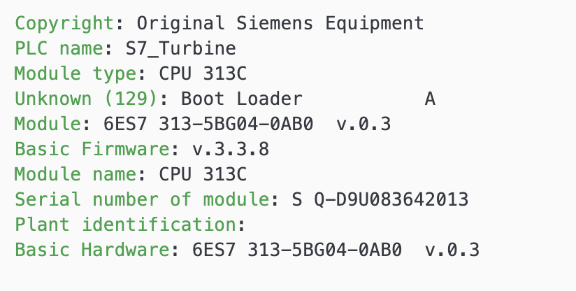
Shodan
the world's first search engine for Internet-connected devices
Works by randomly finding IPs and testing a random port
Used by defenders to understand what's publically available
Shodan interacts with only services running on the devices
Helps identify vulnerable services

Slide 12

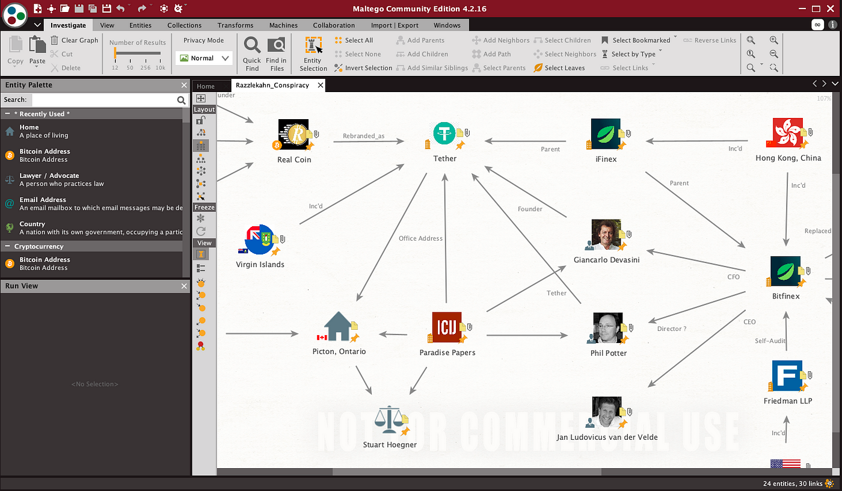
Maltego
Gathers data on an entities and graphically represents relationships
Run functions on entities
Create your own manually
On kali
Example Functions
Facebook search , Facebook friends
whois lookup
DNS lookup

Slide 13
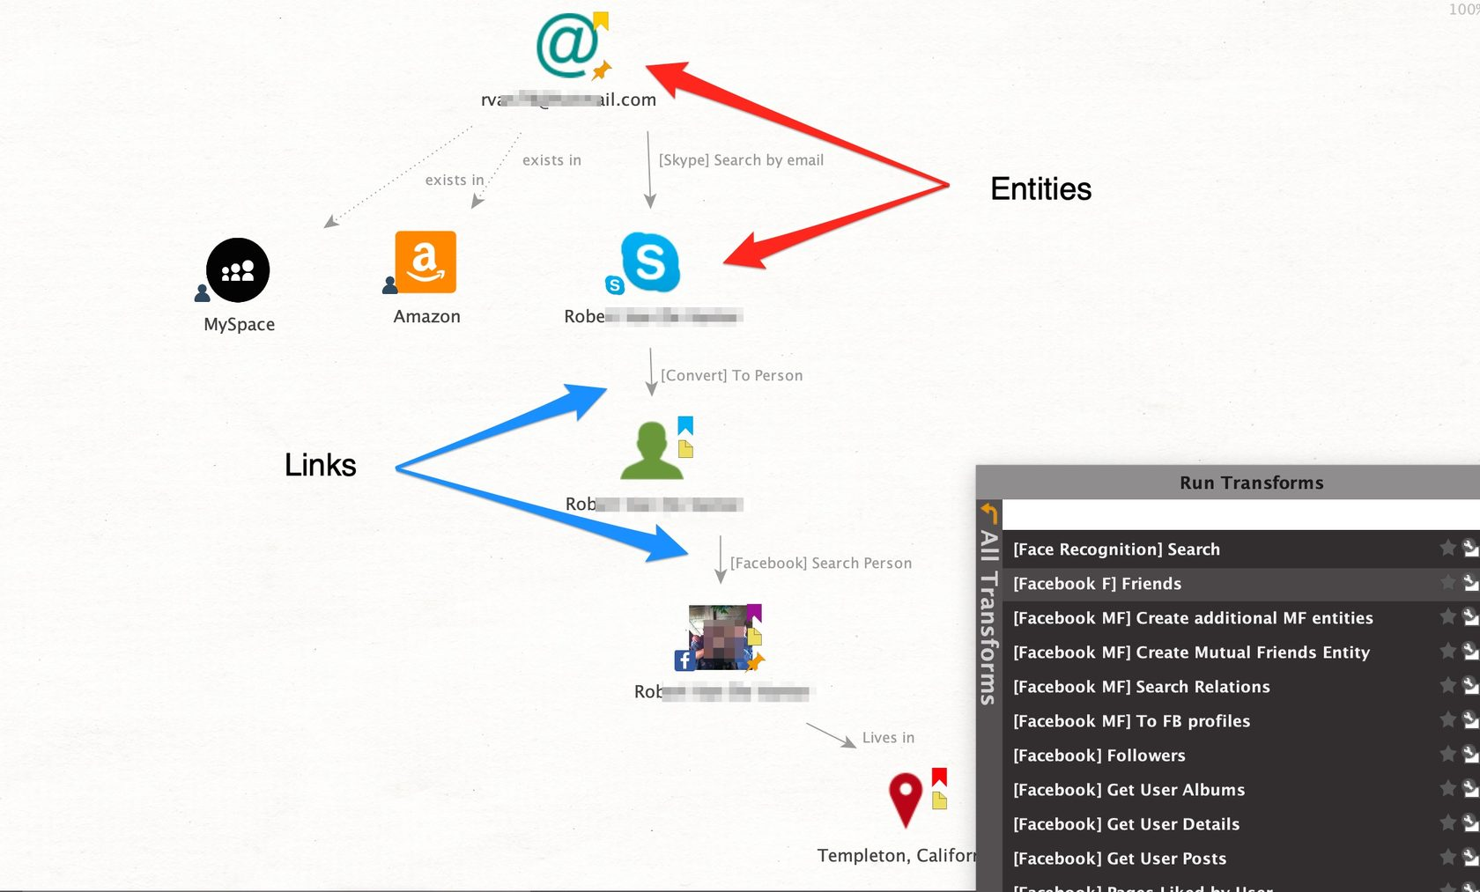

Slide 14

Google Advanced Search
Taking advantage of advanced search features on google to find vulnerables indexed websites.
Examples:
Intitle:’login’
filetype:’.mp4’
Find .env files, password files, etc.
List of commands of exploit db
intitle:index.of jpg
Finds sites image directories
DON’T BREAK THE LAW

Slide 15
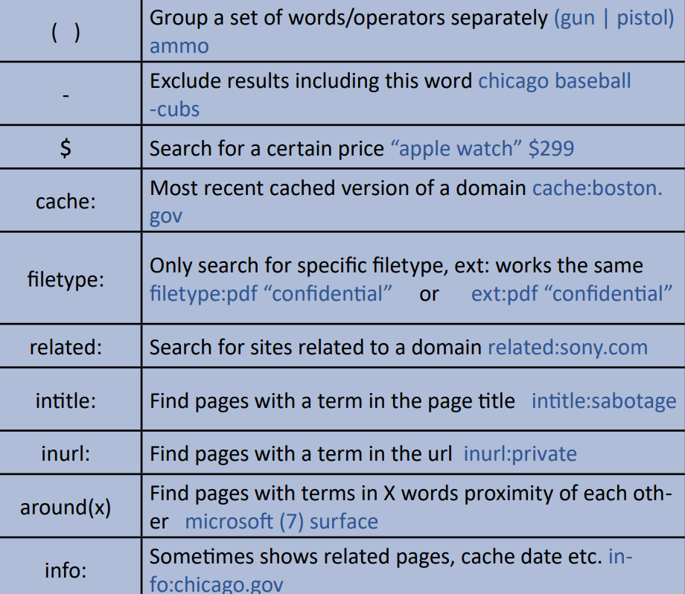

Slide 16
Images - Location
Reverse image search to find the image
  https://tineye.com/
  https://images.google.com/
Find similar images
  Google lens
Look for clues in the image
  Signs
  Buildings
  Terrain
Location Metadata

Slide 17
Images - Metadata
What is metadata
Types of data
  How
  Where
  When
Tools
  Properties in photo viewer
  Special tools (exiftool etc.)
  Online tools
Notes:
Every image has metadata -

Slide 18
Practical
https://shefesh.com/sessions/r/picture_challenge_1 - 5
https://shefesh.com/sessions/r/passport
https://shefesh.com/sessions/r/medical_form

Slide 19
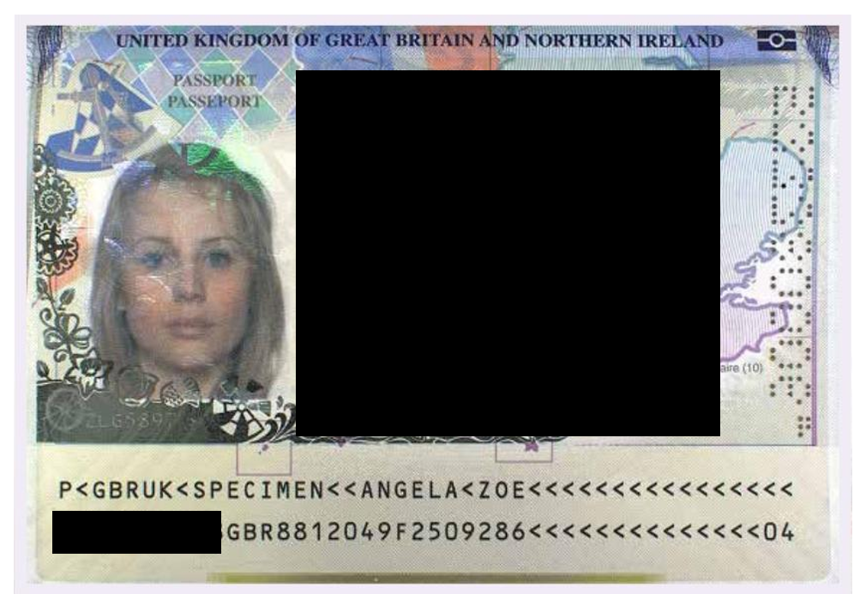
https://drive.google.com/file/d/11iTtGieLUtNrEiGaK48oRu73PbqQcijO/view?usp=sharing

Slide 20

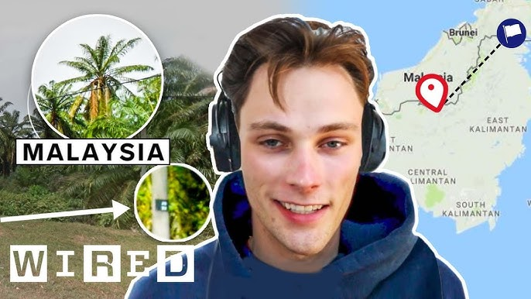
Geoguessr
BIG GAME OF GEOGUESSR!!!
GO TO: geoguessr.com/join

Slide 21
Useful resource
https://www.osintdojo.com/resources/

Slide 22
Upcoming Sessions
What’s up next?
www.shefesh.com/sessions

Slide 23

Any Questions?
www.shefesh.com
Thanks for coming!

